Slide 1

Design and Implementation of AI Based Agri Robot
Chetan Gujarathi
Nandan Kasat
Prajwal Nikam
Under the Guidance of
Prof. Dr. S.S.Morade

Slide 2
Index
Introduction
Literature Survey/review
Block Diagram
Project Specification
Design and simulation
Advantages and Applications
Future Scope
Project Completion Plan
References

Slide 3
Introduction
In recent years, technological innovation in the field of agriculture has advanced dramatically, and a new scientific field has emerged that effectively utilizes data to improve accuracy and agricultural productivity and minimize environmental impact.
Artificial Intelligence (AI) is starting to play a significant role in our daily lives, expanding our perceptions and our ability to change the environment around us. AI is a new technology in agriculture.
AI-based devices and machines have taken today's agricultural systems to another level.

Slide 4
The technology has improved crop production and improved real-time monitoring, harvesting, processing, and marketing the latest technology in automation systems using agricultural robots.
The technology has improved crop production and improved real-time monitoring, harvesting, processing, and marketing the latest technology in automation systems using agricultural robots and drones has made a significant contribution to the agriculture-based sector.
Image processing is categorized as signal processing and is commonly used to make multiple modifications to an image in order to enhance it or extract desired data or information from the acquired image.
The process is straightforward, starting with a camera capturing an image, then using an image processing system such as deep learning to process the captured image and derive the required information from it.

Slide 5
The aim of this research is to develop a low-cost agricultural robot for spraying herbicides on farmland and recording their paths.
To keep costs as low as possible, the herbicide spray robot prototype was assembled from simple, inexpensive, off-the-shelf components.
The agricultural robot developed for this study focuses on four applications:
To make intelligent robot to spray Herbicides.
To sense the grass density based on decision of nozzle adjustment.
To sense the obstacles in front of it and take decision.
To memorize/record the path.

Slide 6
Literature Survey/Review
Sr.No | Author | Year | Title | Description
1 | A.M. Kassim, A. H. Azahar, S Sivarao. | February 2020 | Design and Development of Autonomous Pesticide Sprayer Robot for Fertigation Farm | This paper presents a system, specially designed and developed for chili fertigation farm spraying through a robotic system. This paper aims to design an uplifted spraying robot as well as including navigation system also.
2 | Anirudha .S. Tadpatri, Pramod P Ugargol, Rakesh Shridhar. | September 2021 | Autonomous Herbicides Spraying System Using AI and IOT. | This paper describes a system build and modeling an autonomous spraying system using AI. For navigation system they used controller board, GPS, Compass module for retrieving GPS coordinates and heading data, motor driver and motors. For spraying they take input from image processing system.

Slide 7
3 | Mitul Raval, Aniket Dhandhukia, Supath Mohile | August 2015 | Development and Automation of Robot with Spraying Mechanism for Agricultural Applications | Design and construction of an autonomous mobile robot for use in pest control and disease prevention applications in commercial Farm. Pesticide spraying mechanism designing the chassis for robot.
4 | Palash Patil, Vaibhav Pardhi, Prashant Balkhande. | May 2017 | Development and Automation of Robot with Spraying Mechanism for Agricultural Applications | Purpose of this project is to implemented spraying robot because disease caused to spray pesticides to get farmer infected, diseases like soil borne, water borne, air borne
5 | S.M. Pedersen, S. Fountas | April 2015 | Agricultural robots: an economic feasibility study | Design of economically viable robotic systems for grass cutting, crop scouting and autonomous weeding.

Slide 8
6 | G.Y. Rajaa Vikhram, Rakshit Agarwal, Rohan Uprety, V.N.S. Prasanth | July 2018 | Automatic Weed Detection and Smart Herbicide Sprayer Robot | Design This paper presents a system, specially designed and developed for chili fertigation farm spraying through a robotic system. This paper aims to design an uplifted spraying robot as well as including navigation system also with image processing.
7 | Kamarul Hawari Ghazali, Mohd. Marzuki Mustafa and Aini Hussain | January 2008 | Machine Vision System for Automatic Weeding Strategy using Image Processing Technique | Purpose of this project is to implemented the robot through Fourier Transform. Fourier Transform is a technique to analyze frequency components in a signal. It is common processing technique in signal analysis and image processing to transform the original data into form that easily to process.
8 | Amir H. Kargar B.,Ali M. Shirzadifar | May 2013 | Automatic weed detection system and smart herbicide sprayer robot for corn fields | The goal of this paper is to develop a new weed detection and classification method that can be applied for autonomous weed control robots.

Slide 9
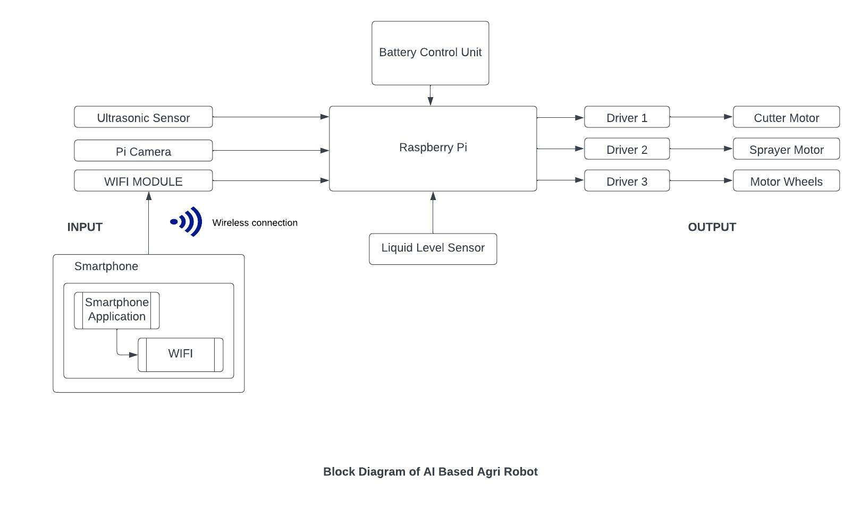
Block Diagram

Slide 10
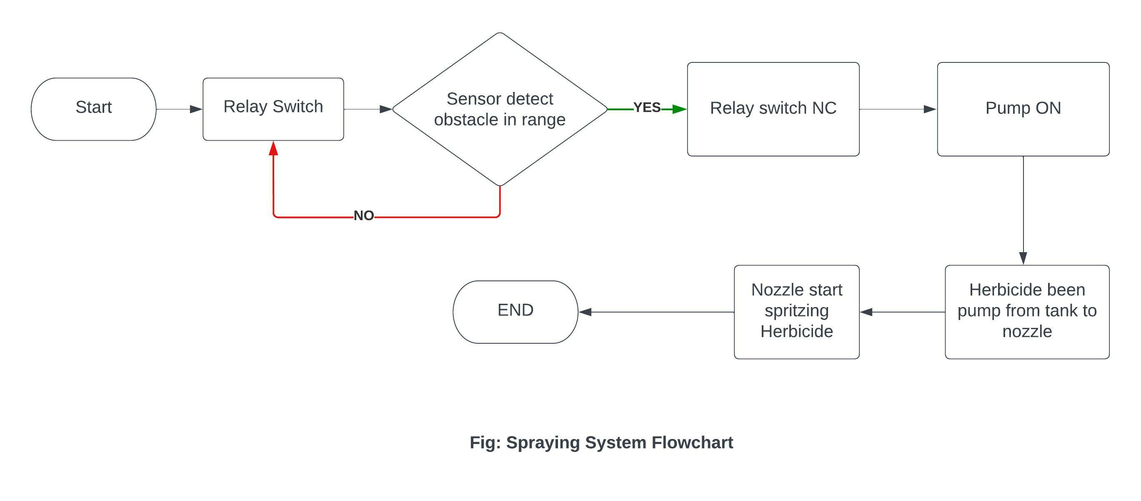
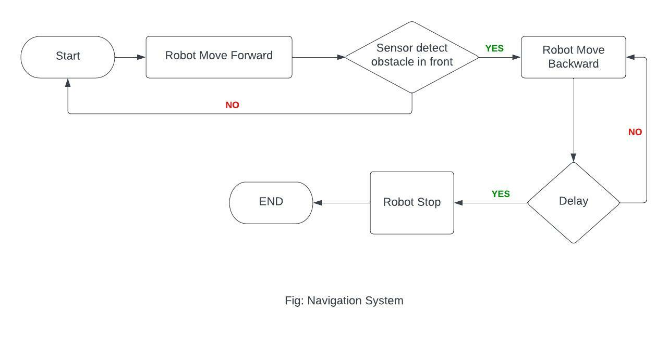

Slide 11
Block Description
Battery Control Unit – The main use of the battery control unit is to store the supply and give it to the controller i.e. Raspberry Pi.
Raspberry Pi Controller – The main parameter of the robot is the Raspberry Pi controller. The input and output parameters of robot are worked through the controller. Upon receiving power from the battery controller, the controller begins accepting inputs and issuing outputs to the appropriate parameters.
Inputs -
a) Ultrasonic Sensor –
The main function of the ultrasonic sensor in Agri Robot is to detect the obstacles which will come in front of the robot.
b) Pi Camera –
The main function of Pi camera in Agri Robot is to record the path of the agriculture field and will memorize it.
After the path recording it will perform function of image processing and will capture the images of the weed and will provide the feedback to the controller so that the nozzle will come into the function and spraying mechanism on weeds will take place.

Slide 12
c) Wi-Fi Module –
The main function of Wi-Fi module in Agri Robot is it will be connected to the app so that the farmer can control the robot and the app will display the herbicide chemical level.
d) Liquid Level Sensor –
The main function of Liquid Level Sensor in Agri Robot is to detect the herbicide level is high or low and will display it on the App.
IV. Outputs –
e) Driver –
The main function of Drivers in Agri Robot is to control the mechanism of the – Cutter Motor, Sprayer Motor and the Wheels of the Robot.
It will give the instructions based on the inputs gained from the controller.
f) Cutter –
The main function of Cutter in Agri Robot is to perform the cutting mechanism for the obstacles detected through the input from the ultrasonic sensor.
Department of Electronics & Telecommunication Engineering
K. K. Wagh Institute of Engineering Education & Research, Nashik.

Slide 13
g) Sprayer –
The main function of Sprayer in Agri Robot is to perform the herbicide spraying based on the input from pi camera and it will adjust the nozzle spraying based on the size of the weed present.
h) Wheels –
The main function of Wheels in Agri Robot is to perform the moving mechanism of the robot.

Slide 14
Project Specification
Raspberry Pi Module.
12V dc 7Ah Sealed Lead Acid (SLA) Rechargeable Battery.
L298 Motor Drive Controller Board Module (for cutter and pump)
Cytron MD10C motor driver (for wheels)
Ultrasonic sensor for obstacle detection.
Heavy Duty 12V DC Electric Battery Sprayer Pump Motor
Raspberry Pi Camera.
Ardupilot flight Controller.
Float Switch Sensor for Water Level Controller.

Slide 15
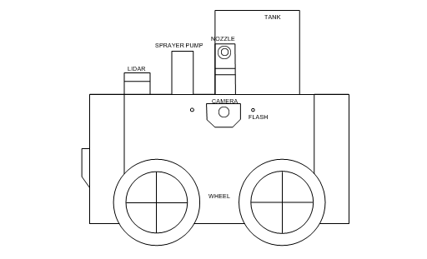
Designing
Fig. 2-D Model

Slide 16
3-D Model

Slide 17
Fig. Top View
Fig. Side View

Slide 18
Fig. Bottom View

Slide 19
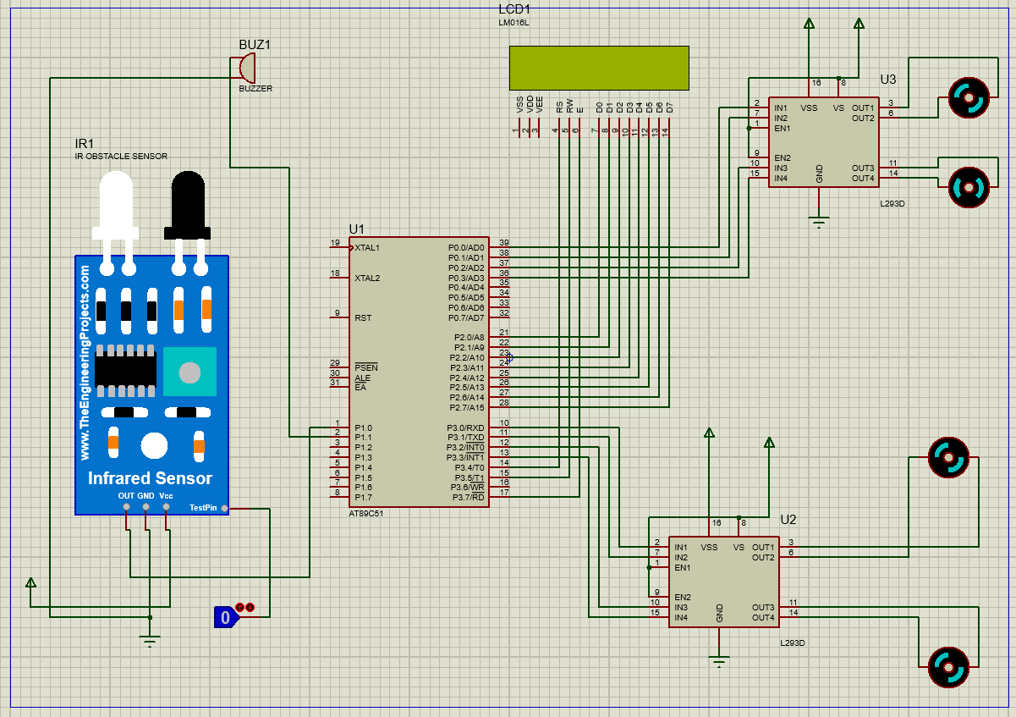
Simulation

Slide 20
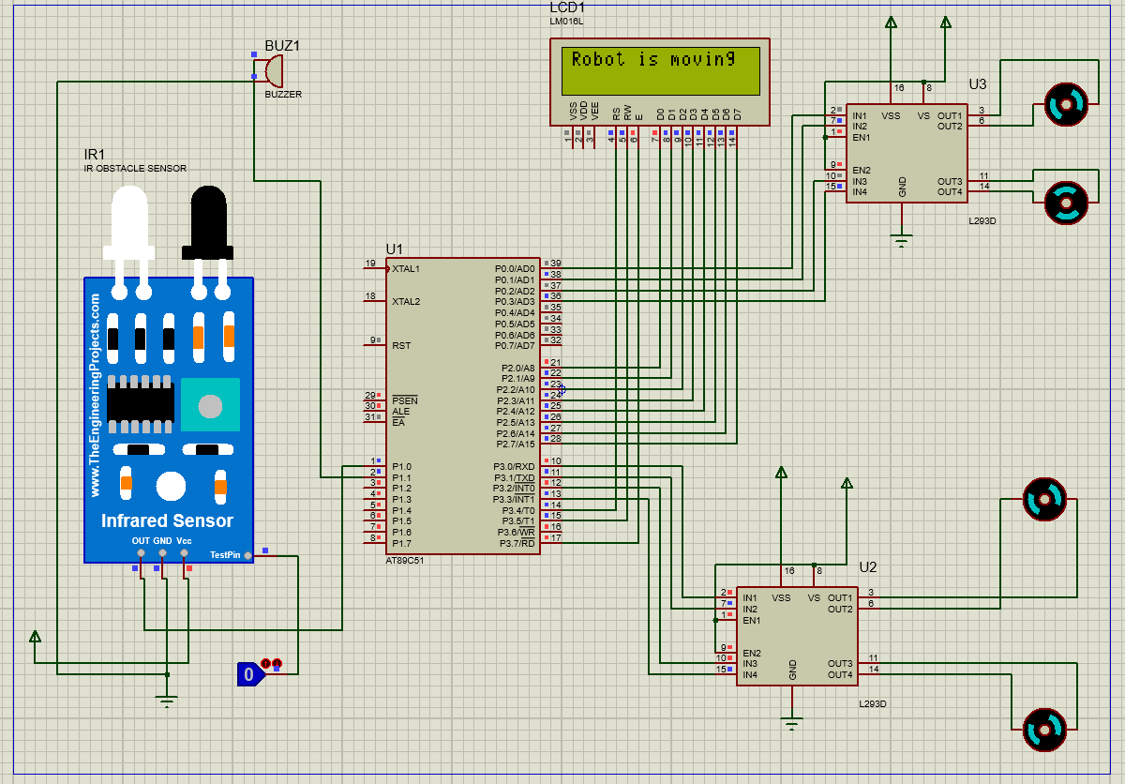
Logic 0 (Robot is Moving)

Slide 21
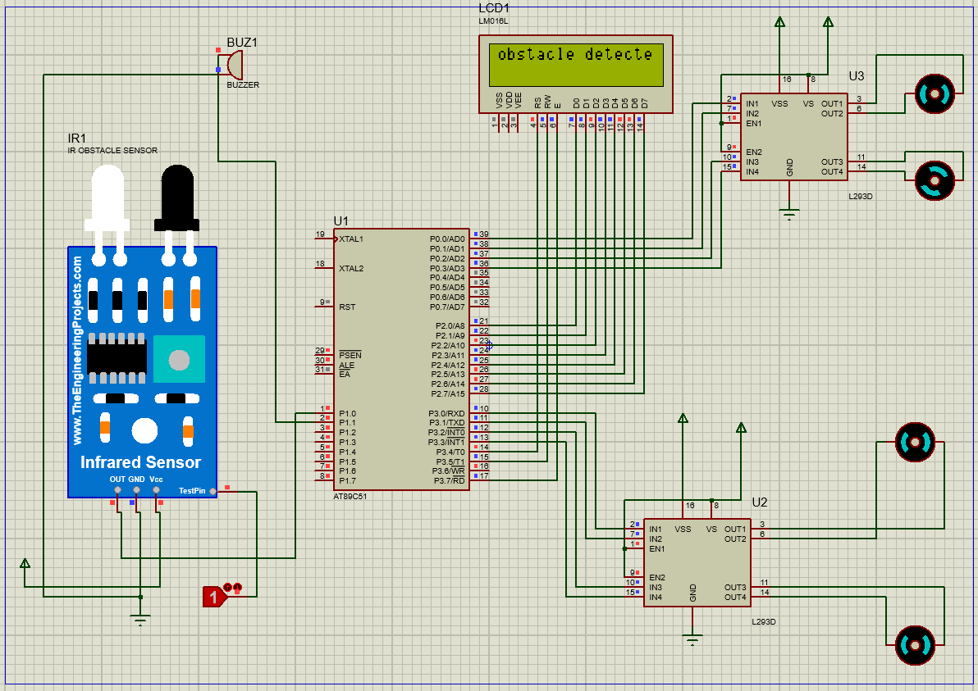
Logic 1(Obstacle Detected)

Slide 22
Advantages and Application
AI enables better decision-making: - Farmers can use AI to collect and process much more data than usual. Analyze market demand, predict prices, and determine the best time to sow and harvest. is an important issue that farmers can solve with AI.
Automatic weeding: - A robot runs through a crop field. The bottom camera shows plants and weeds. AI software detects weeds and issues commands to remove them. High-energy sprinklers remove weeds without disturbing the soil or crops with nozzle settings according to weed size.
Cutting the unwanted grass throughout the path: - The mowing mechanism is to mow unnecessary grass that obstructs the path of the robot and continue the mechanism that the robot sprays herbicides on weeds.
Time Saving: - Most importantly, the robot automatically records the farm's path and navigates through it, saving the farmer time.

Slide 23
Applications –
Agriculture Robotics: - Robotics are widely used in various fields, mainly in manufacturing, to perform complex tasks. Various AI companies are currently developing agricultural robots.
Intelligent Spraying: - AI sensors can easily detect weeds and detect the area affected by weeds. If such areas are found, they can be applied in a targeted manner to reduce herbicide use, saving time and harvesting.
Precision Farming : - Precision farming techniques are highly precise and controlled methods that can replace labor-intensive parts of agriculture to perform repetitive tasks. One example of precision agriculture is the identification of plant stress levels.
Automatic Weeding: - The AI weeding is not just a clever sprayer. Other computer vision robots take a more direct approach to removing unwanted vegetation.

Slide 24
Future Scope
Robots in agriculture can reduce the dependency on human labor to a significant extent.
Efficiency can be improved by increasing the battery capacity and improving the blade design.
Powerful communication and remote controlling systems.
Limiting human intervention by maximizing system automation.
Due to introduction of mobile Agri robot, there would be a large replacement of heavy large tractor will slow.

Slide 25
Project Completion Plan

Slide 26
References
Design and Development of Autonomous Pesticide Sprayer Robot for Fertigation Farm -A.M. Kassim, A. H. Azahar, S Sivarao.
Autonomous Herbicides Spraying System Using AI and IOT - Anirudha .S. Tadpatri, Pramod P Ugargol, Rakesh Shridhar.
Development and Automation of Robot with Spraying Mechanism for Agricultural Applications - Mitul Raval, Aniket Dhandhukia, Supath Mohile.
Development and Automation of Robot with Spraying Mechanism for Agricultural Applications - Palash Patil, Vaibhav Pardhi, Prashant Balkhande.

Slide 27
Weed Detection Using Image Processing - Ajinkya Paikekari, Vrushali Ghule, Rani Meshram, V.B. Raskar.
Crop and Weed Detection Based on Texture and Size Features and Automatic Spraying of Herbicides - Amrutha A. Aware, Kavitha Joshi .
Autonomous Herbicide Spraying System using AI and IoT - Prajwal B , Rakesh Shridhar , Anirudha S Tadpatri Pramodh P Ugargol, Ajjaiah H B M.
Machine Vision System for Automatic Weeding Strategy using Image Processing Technique - Kamarul HG, Mohd MM &Aini H.
Automatic Weed Detection System and Smart Herbicide Sprayer Robot for corn fields - Amir HKB & Ali MS .
Automatic Weed Detection and Smart Herbicide Sprayer Robot- G.Y. Rajaa Vikhram, Rakshit Agarwal, Rohan Uprety, V.N.S. Prasanth .

Slide 28
Questions

Slide 29
Thanks

